Slide 1

Mobile Apps Using Android
Android Development

Slide 2

OVERVIEW OF ANDRIOD DEVELOPMENT
As discussed earlier, android applications are created in JAVA and are executed by Dalvik VM.
Android applications written in JAVA is compiled and converted to a class file. The dx tool in Android SDK converts the java file into .dex file. The .dex file and is executed by DVM to produce the output.
The Android asset packaging Tool in Android SDK packages the .dex file and the other resources of the Android Application like images files etc. into .apk(android Package file.
The .apk file represent the android executable with all necessary resources and can be deployed in any android device using adb(Android Debug Bridge) tool.
Packaging is done and the .apk file is created, deployed and started when the user selects the android application to deployed.

Slide 3
OVERVIEW OF ANDRIOD DEVELOPMENT
An Android applications compromise of the following components
Activity
Service
Content Provider
Broadcast Receivers
Each component accomplish a specific task. The android manifest file contain information about all the components created in an android application specific hardware and software requirement.
Activity:
It represent one single screen in a android application. It is created by extending andriod.app.activity. These has to be declared in Android manifest.xml. Activities is composed of views.
Ex: Text view, Button etc.

Slide 4
OVERVIEW OF ANDRIOD DEVELOPMENT
Service:
Service is an android application that runs in the background. It is called faceless activity and does not provide any UI. It is used for time consuming activities or to accomplish task for remote process. Ex: downloading the games etc and allows user to make calls while downloading.
Content provider:
It is used to share the data within and across applications. Data can be persisted in a flat file system, SQLlite data base. Other APPS with appropriate permission can use the content provider to access to manipulate shared data.
Broadcast Receivers:
A broadcast receiver (receiver) is an Android component which allows you to register for system or application events. All registered receivers for an event are notified by the Android runtime once this event happens.

Slide 5
Broadcasts
These broadcasts are sent when an event of interest occurs. For example, the Android system sends broadcasts when various system events occur, such as when the system boots up or the device starts charging. Apps can also send custom broadcasts, for example, to notify other apps of something that they might be interested in (for example, some new data has been downloaded).
Apps can register to receive specific broadcasts. When a broadcast is sent, the system automatically routes broadcasts to apps that have subscribed to receive that particular type of broadcast.
Generally speaking, broadcasts can be used as a messaging system across apps and outside of the normal user flow.

Slide 6
APPLICATION PROJECT STRUCTURE
Within each Android app module, files are shown in the following groups:
manifests
Contains the AndroidManifest.xml file.
java
Contains the Java source code files, separated by package names, including JUnit test code.
res
Contains all non-code resources, such as XML layouts, UI strings, and bitmap images, divided into corresponding sub-directories. For more information about all possible resource types, see Providing Resources.

Slide 7
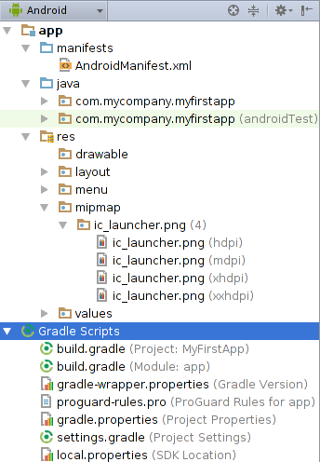
Android Project structure

Slide 8
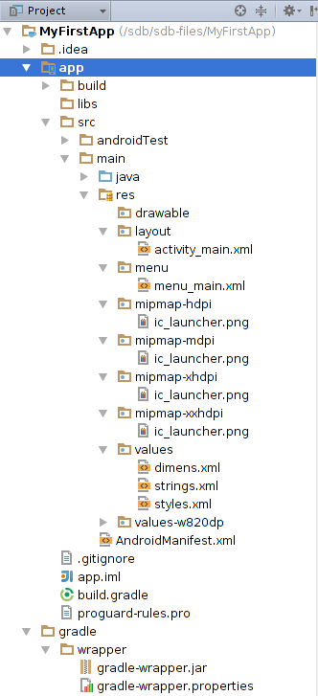

Slide 9
Reference link to android development
https://developer.android.com/studio/projects/index.html
For specific information about configuring continuous integration for your Android project using Jenkins and Firebase Test Lab, see Using Firebase Test Lab for Android with Continuous Integration Systems.
https://firebase.google.com/docs/test-lab/continuous

Slide 10
ANDROID MANIFEST FILE
Android manifest.xml file is used to configure all the information related to an android application. When the android is first loaded, the first file that would be searched by the system would be the manifest file.
Working:
These file contains the required configuration information to successfully install an application in the android device. It includes class names, events that the application can act upon and permission to perform certain operations like internet access, file download etc.

Slide 11
ANDROID MANIFEST FILE
Responsibility of manifest file:
Appropriate user permission set for an application
Declaration for minimum API level required for the android application
Specify the required hardware and software functionalities Ex Bluetooth/camera
Specify API libraries that the application has to link to access other services like google maps library
https://developer.android.com/guide/topics/manifest/manifest-intro.html

